Slide 1
TECHNICAL MECHANICS
AMOS MUNENE MUTHEE
E222-01-2376/2023

Slide 2
DETAILS
Customer: Crossing Networks ltd
Capacity of work: Design Engineer

Slide 3
PROBLEM STATEMENT
Problem: Frequent structural bridge failure when a four-wheel vehicle drives on it
Reason (s): Uneven expansion and contraction of the bridge and low material strength
Solution: Construction of a simply supported beam with roller ending with high weight supporting strength

Slide 4
METHODOLOGY
Identification of Fundamental variables
Conceptual Sketch generation
Shear force and Bending Moment Diagram
Inputs factors (Prone to change)
Force
Distance
Outputs factors
Shear Force values
Bending Moment values

Slide 5
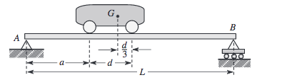
Conceptual analytical sketch
https://www.chegg.com/homework-help/questions-and-answers/1-bridge-idealized-simply-supported-beam-ab-length-l-shown-figure-1-four-wheeled-vehicle-w-q26552777

Slide 6
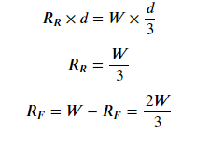
SHEAR FORCE AND BENDING MOMENT ANALYSIS
REACTION FORCES Rr (Rear wheel) and Rf (front Wheel)

Slide 7
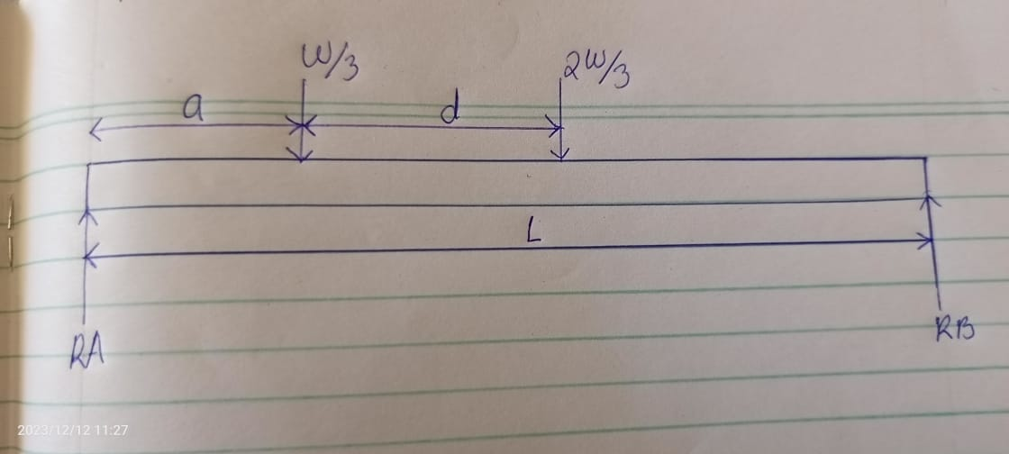
SHEAR FORCE AND BENDING MOMENT ANALYSIS
Free Body Diagram

Slide 8
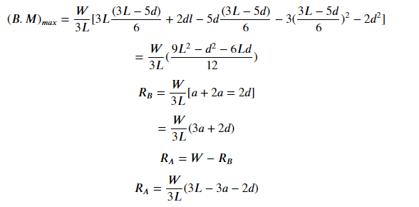
SHEAR FORCE AND BENDING MOMENT ANALYSIS
Reactions at Ra and Rb

Slide 9
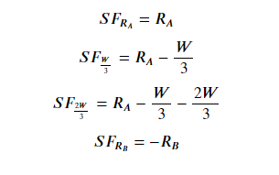
SHEAR FORCE AND BENDING MOMENT ANALYSIS
Shear Force Calculations

Slide 10
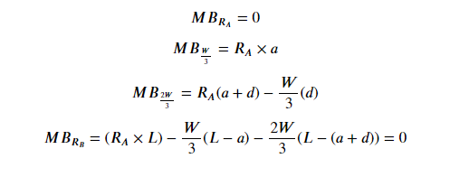
SHEAR FORCE AND BENDING MOMENT ANALYSIS
Bending Moment calculations

Slide 11
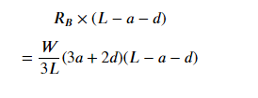
SHEAR FORCE AND BENDING MOMENT ANALYSIS
Maximum Bending Moment Calculations

Slide 12
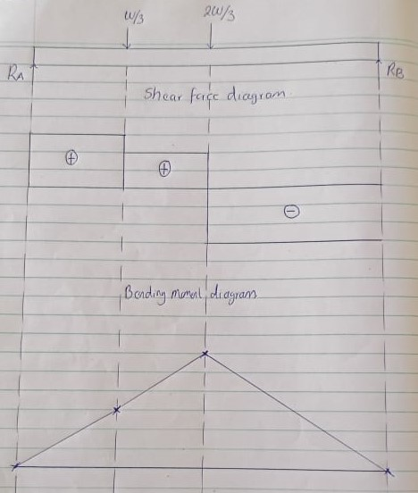
SHEAR FORCE AND BENDING MOMENT ANALYSIS
Analysis Diagram

Slide 13
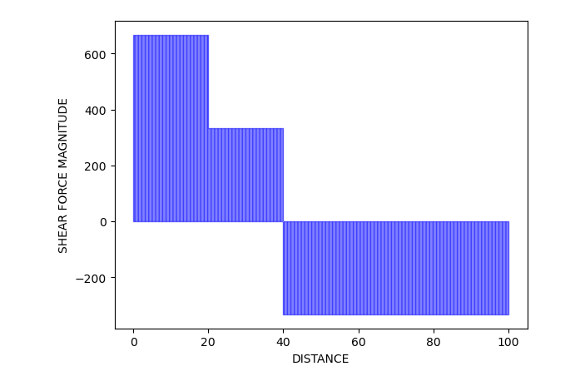
SHEAR FORCE DIAGRAM FROM CODE
Sample result
Note: The geometry of the diagram changes depending on the fundamental variables

Slide 14
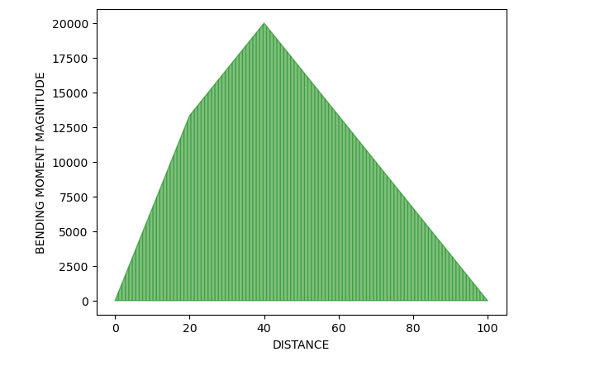
BENDING MOMENT DIAGRAM FROM CODE
Sample
Note: The geometry of the diagram changes depending on the fundamental variables

